Slide 1

Internship Final Presentation
By Aleyna Torres

Slide 2
Introduction To
MediConnect Clinic
(Week 1)
Our Main Goal
Focus on treating patients and securing their safety.
Who We Treat
Our Motto
"Protect the information Protect the mission."
Patients from Adolescents - Elderly are welcome.

Slide 3
Two weeks ago, MediConnect Clinic experienced a cybersecurity incident where an unauthorized person entered the main system.
Used DNS Tunneling to bypass network security,
Preformed an XSS attack (malicious script/code into a website) to change the content and log into an employee account,
Allowing the person to reach their main goal: rerouting medications to an unknown location.
Risk Story (Week 2)

Slide 4
Business Impact
(Week 2)
Workers & Patients lost trust and appointments were temporarily paused.
HIPPA, DEA, and Law Enforcement were alerted.
Approximately $980,000 in losses per day.

Slide 5
Required Meetings
Required meetings and trainings about internet/computer safety
MFA
MFA is a security process that requires two+ forms of verification and has been enabled (Password – key card ID.)
MFA
Logs have been enabled for the system ex: entering/leaving the system.
Implemented Incident
Response (Week 2)

Slide 6
Defender Awareness
Campaign (Week 3)
Target Behaviors
Priority Audiences
1. Use a password manager.
2. Never share credentials/personal information.
3. Always review attachments, links, and emails for suspicious ideations.
4. Adaptive learning programs; training for ALL employees.
5. Use the system of reporting suspicious activity.
All Employees
IT/Infrastructure Team

Slide 7
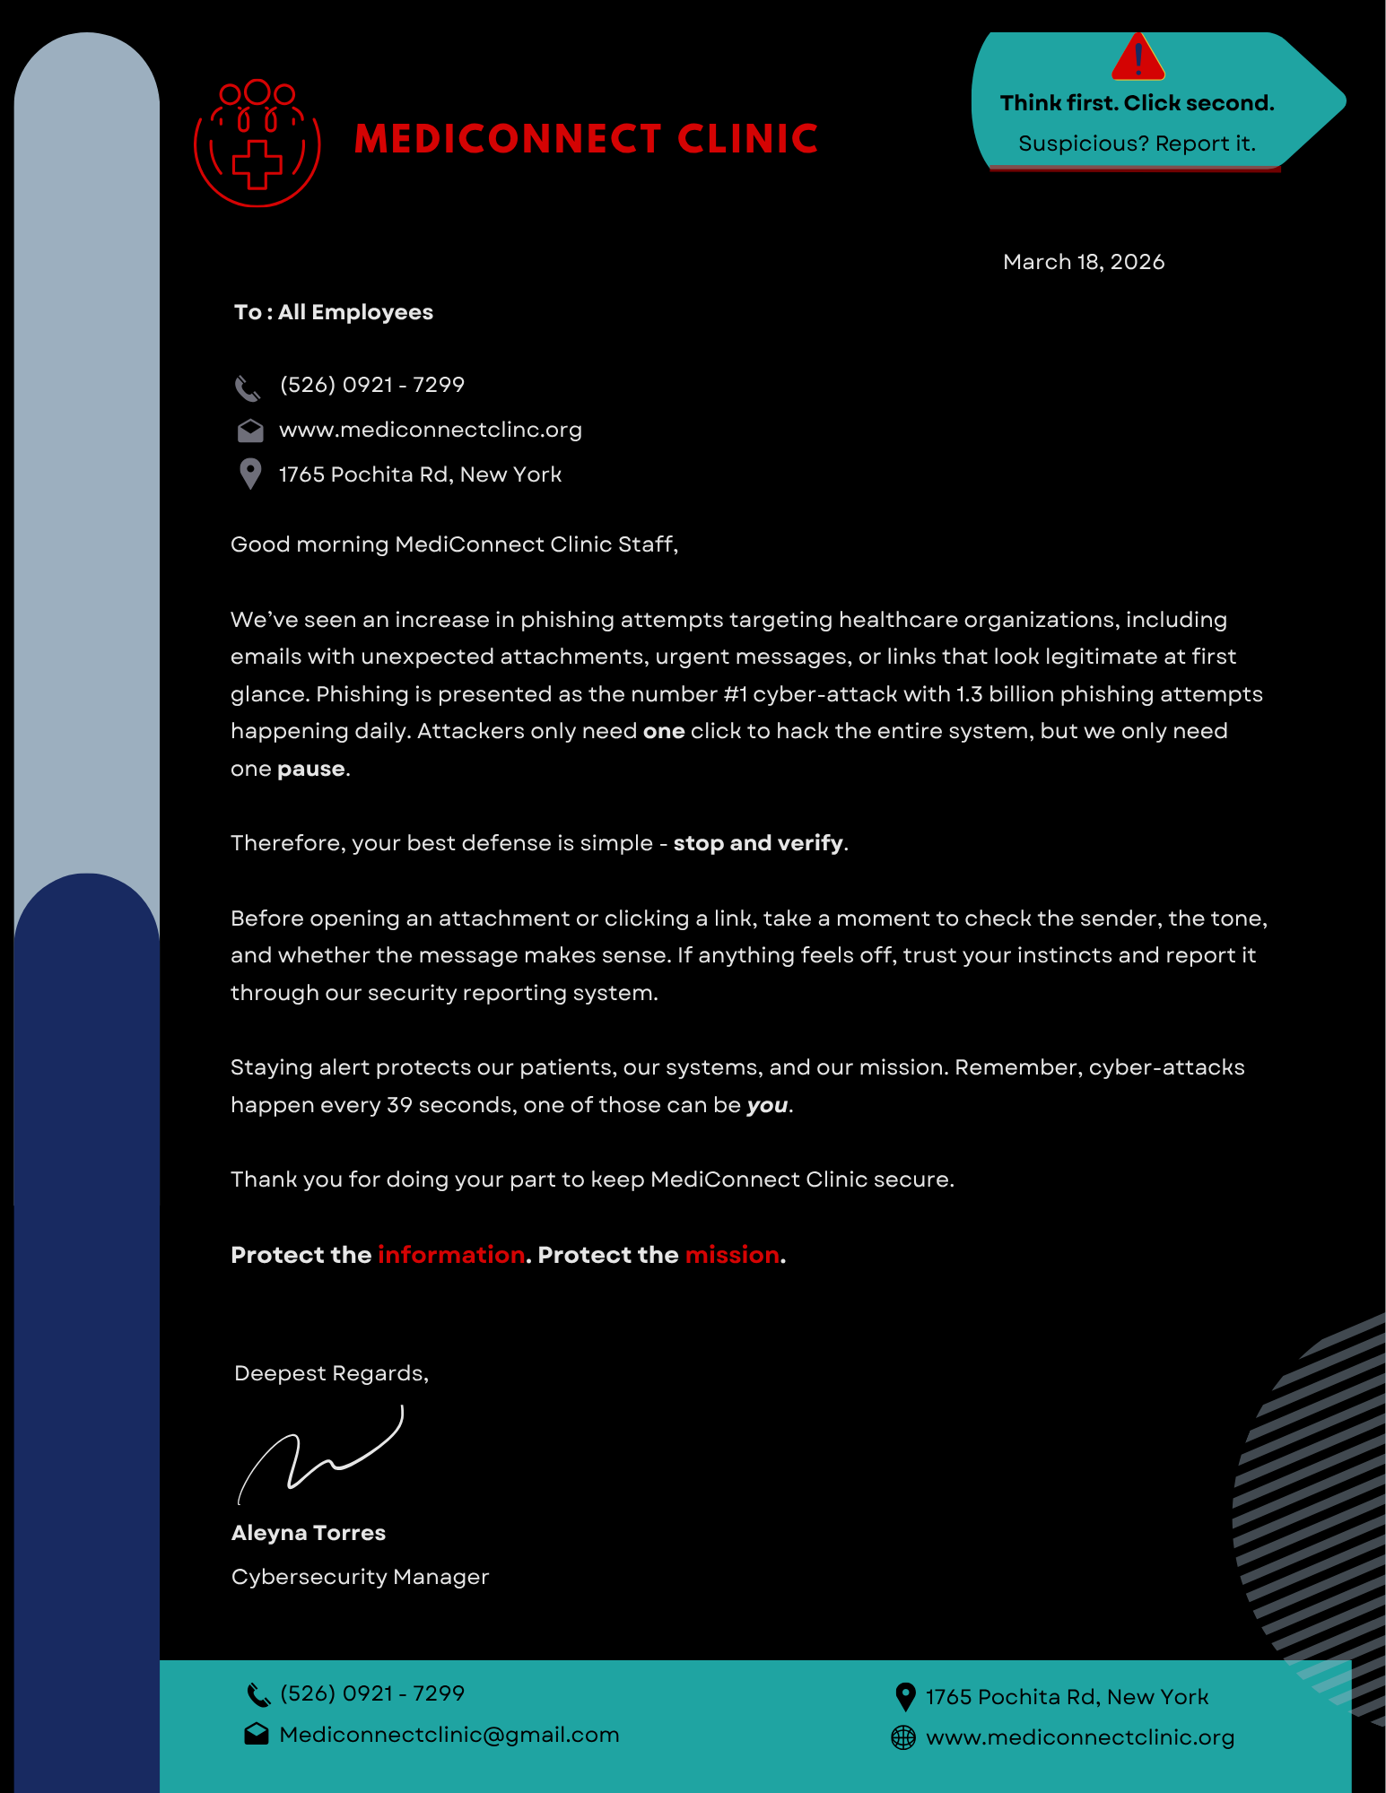
Awareness Artifacts
Gallery (Week 3)

Slide 8
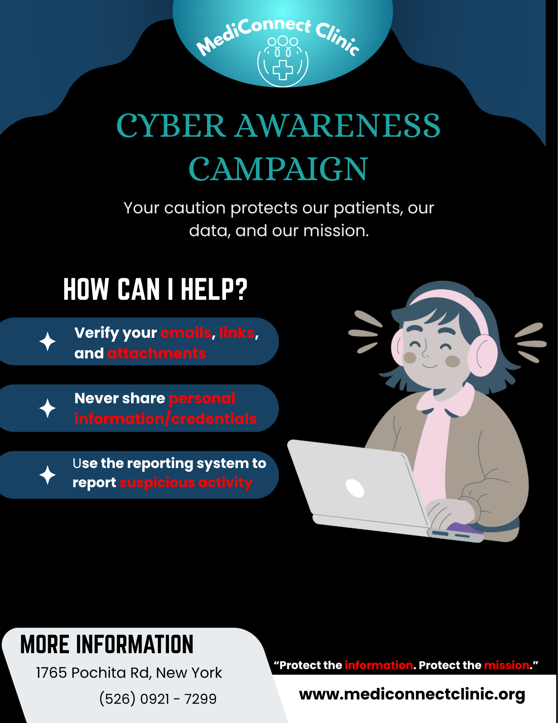
Awareness Artifacts
Gallery (Continued)

Slide 9
1
Alignment was fixed.
MFA is now clearer and understood by all.
2
Removed animations and smoothed out the transitions.
Added more details and rephrased words in BOTH artifacts.
Pilot Feedback/Changes
(Week 4)

Slide 10
Thank you!
“Protect the information. Protect the mission.”

